Slide 1

Bias vs Variance
The prediction error of any ML algorithm can be grouped down to:
Bias Error
Variance Error
Irreducible error
We get high Bias when the mapping function learned by a model are simplified w.r.t complexity of data.
We get high Variance when mapping function learned by a model is too complex w.r.t complexity of the data.

Slide 2
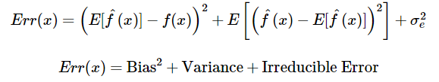
Bias vs Variance
The prediction error of any ML algorithm can be grouped down to:
Bias Error
Variance Error
Irreducible error
Mathematically,
We get high Bias when the mapping function learned by a model are simplified w.r.t complexity of data.
We get high Variance when mapping function learned by a model is too complex w.r.t complexity of the data.

Slide 3
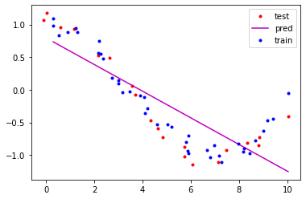
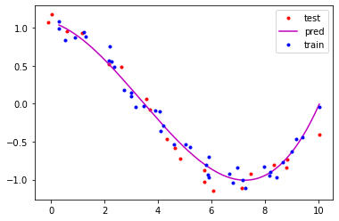
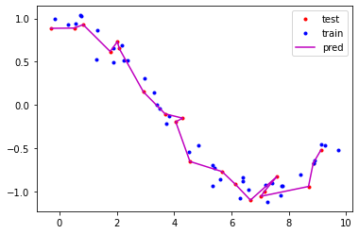
High Bias Low Variance Just Right Trade-off Low Bias High Variance
Simple Model(straight line) Complex Model(Higher order curve)

Slide 4
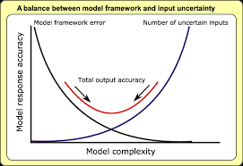
Model Complexity vs error
#Source - Researchgate.net

Slide 5
If model which is unable to match the higher complexity of data is called as underfit.
These models usually have high bias and low variance.
Underfitting happens when we have very less amount of data to build an accurate model.
Or when we try to fit a simple model like linear model with a complex data like nonlinear data.
If model which is of higher complexity than the complexity of data is called as overfit.
These models have low bias and high variance.
Overfitting happens when our models are very complex like Decision trees which are prone to overfitting and the data is too simple.

Slide 6
Diagnosing Bias and Variance
The most practised way to carry out analysis about bias and variance of any model is plotting validation and training errors on a graph.
Model performing good on training data and at the same time if it performs poorly on validation data, the model is suffering from overfitting or High Variance.
Model performing poor good on training data as well as on validation data, the model is suffering from underfitting or High Bias.

Slide 7
How to improve performance?
Model suffering from high Bias?
Try adding new features.
Try adding polynomial features.
Increasing Data will not help.
Try to train a more complex model.

Slide 8
Model suffering from high Variance?
Try reducing features.
Try Regularization.
Increasing Data will help a lot.
Try to train a simpler model.

Slide 9
To learn more , refer...
Gentle Introduction to the Bias-Variance Trade-Off in Machine ...
https://machinelearningmastery.com
Understanding the Bias-Variance Tradeoff | by Seema Singh ...
https://towardsdatascience.com
Bias and Variance Tradeoff | Beginners Guide with Python ...
https://www.analyticsvidhya.com

